Slide 1
Eco Bike Rental
Group 5

Slide 2
Members in group
Nguyen Thai An
Vu Minh Hoang
Bui Tu Hoang
Nguyen Manh Khang

Slide 3
Contents
Interaction Diagram
Class Diagram
Design Considerations
Member Contribution

Slide 4

Member contribution

Slide 5
Contribution EVALUATION

Slide 6
Contribution EVALUATION

Slide 7
Interaction Diagram

Slide 8
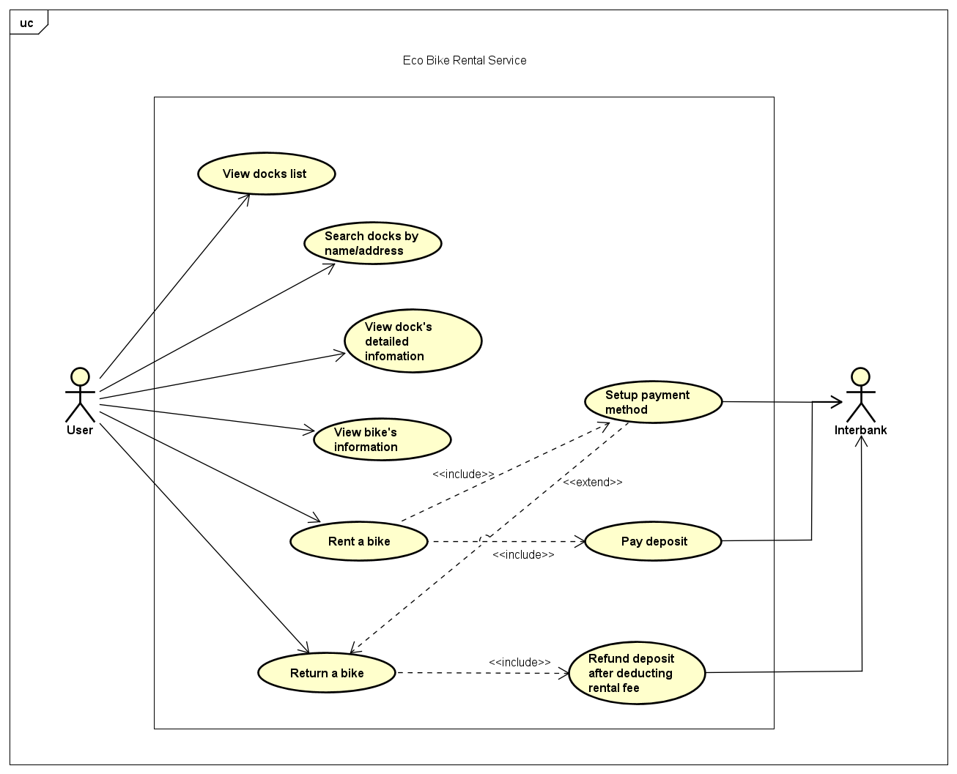
EBR use case diagram

Slide 9
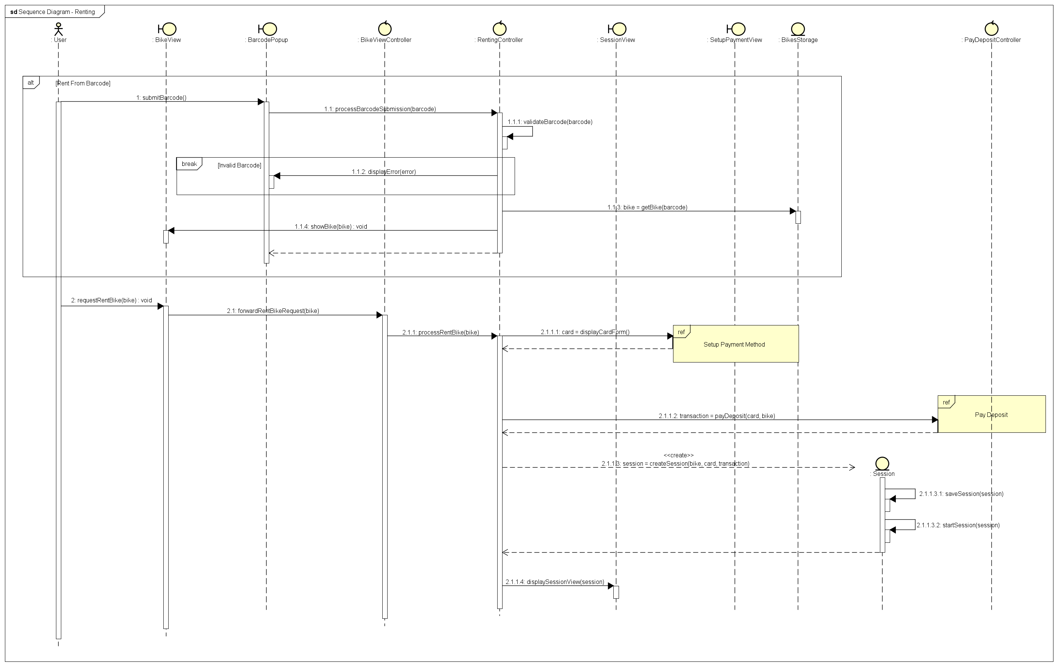
Interaction Diagram – Renting BIKE

Slide 10
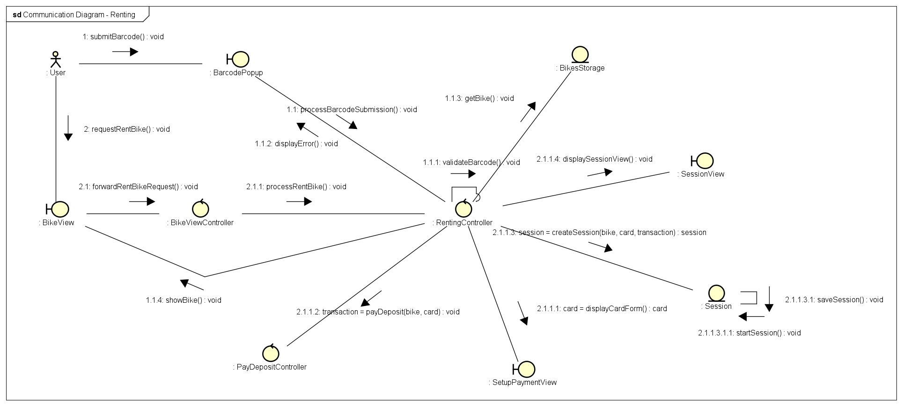
Interaction Diagram – Renting BIKE

Slide 11
Class Diagram

Slide 12
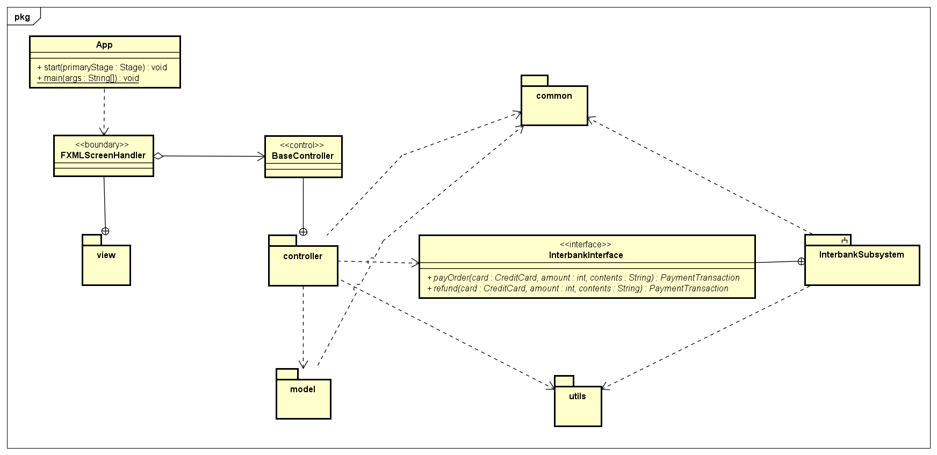
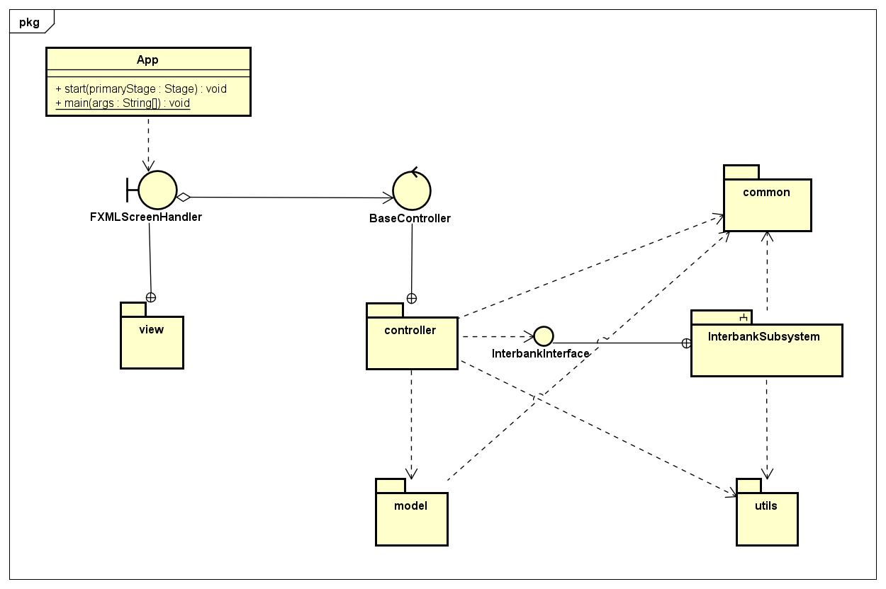
Class Diagram - App

Slide 13
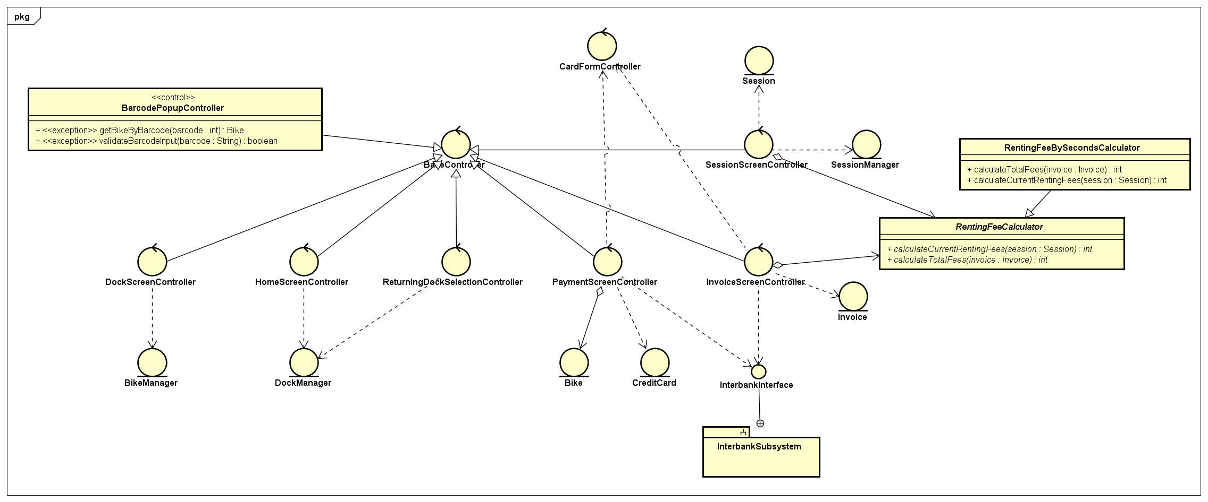
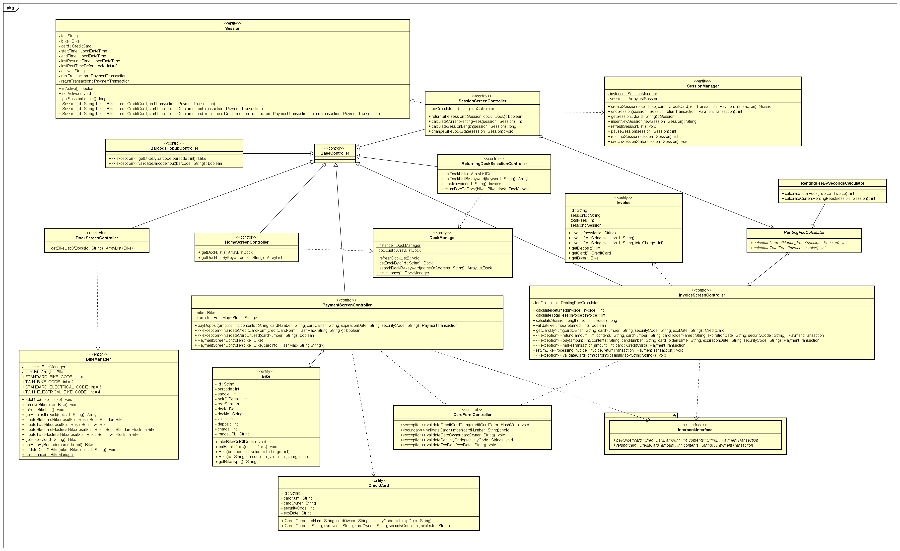
Class diagram – Controller

Slide 14
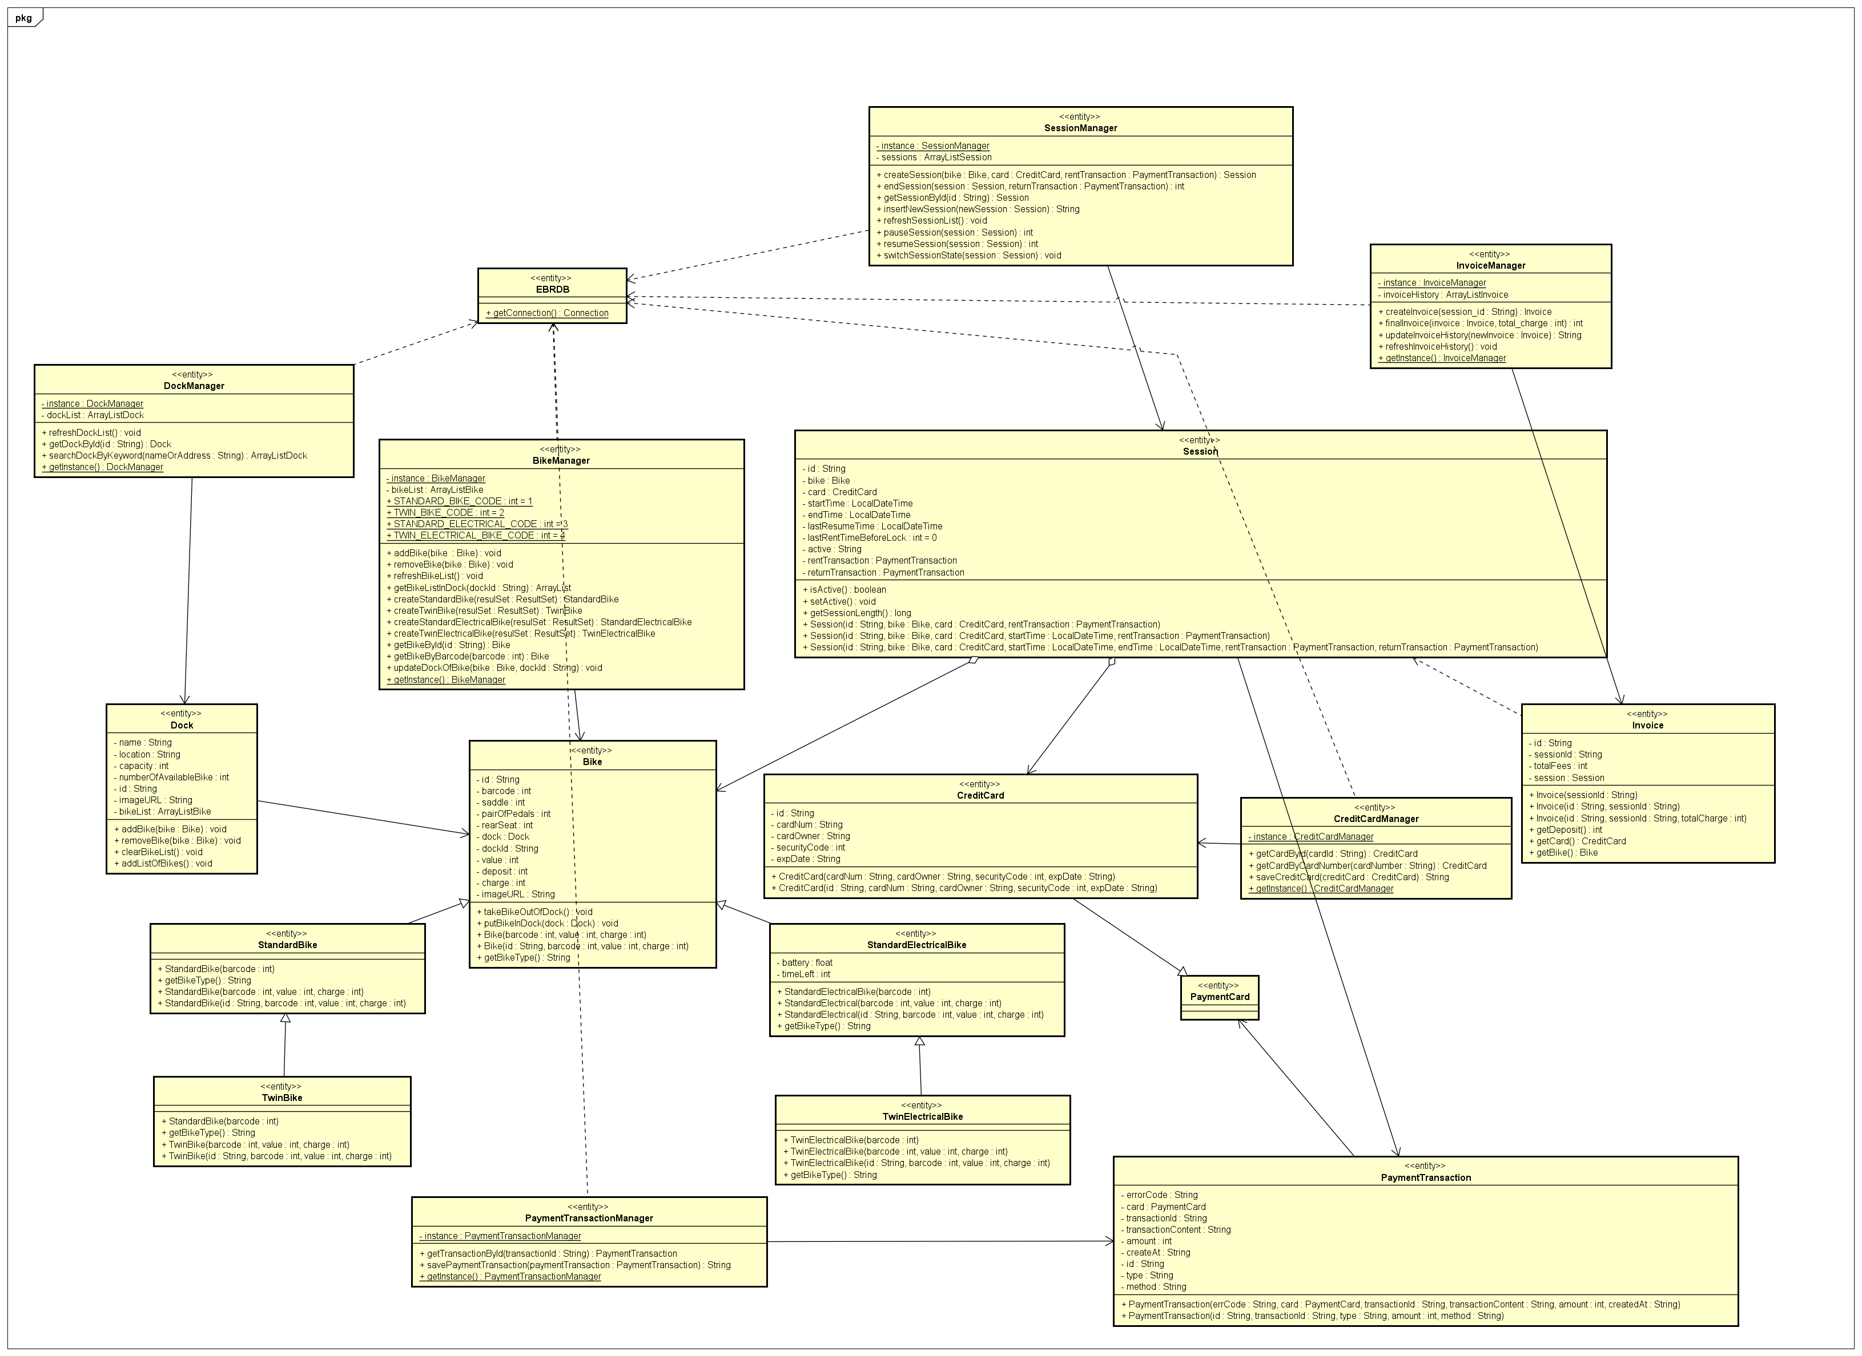
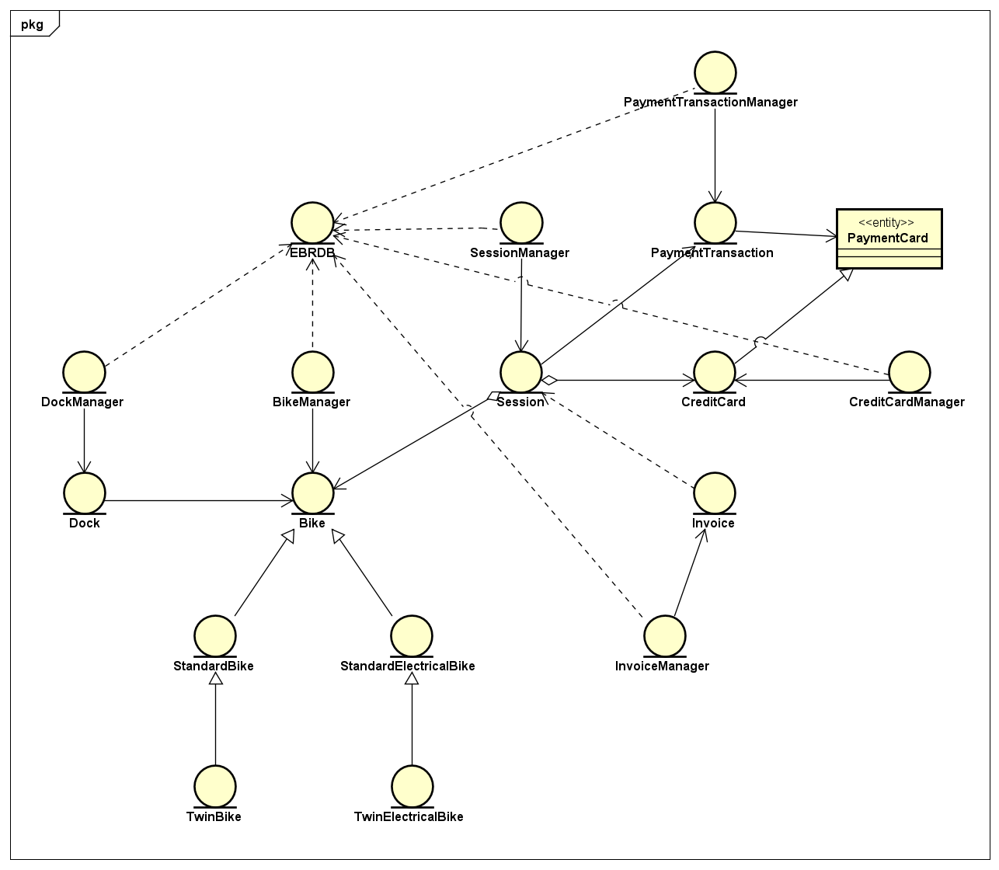
Class diagram – Model

Slide 15
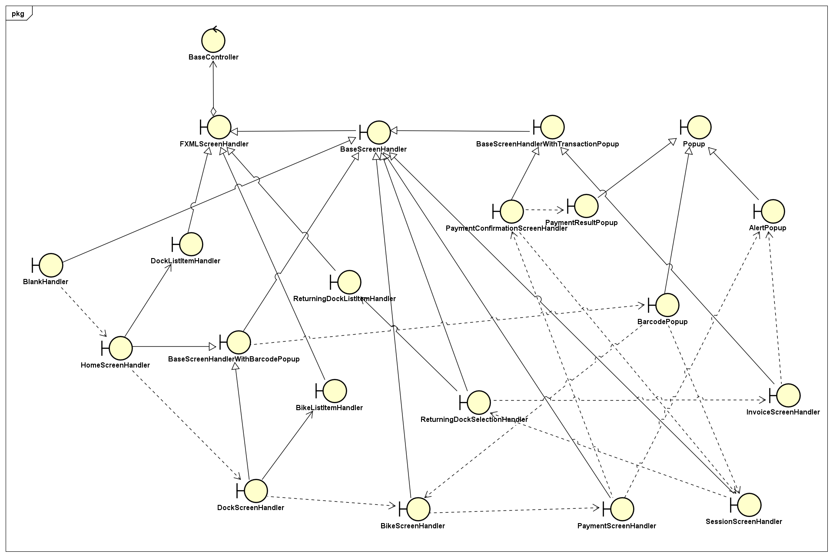
Class diagram – View

Slide 16
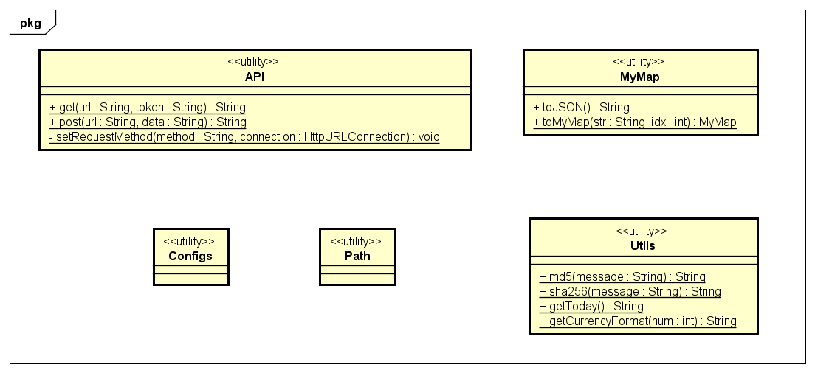
Class diagram – Utils

Slide 17
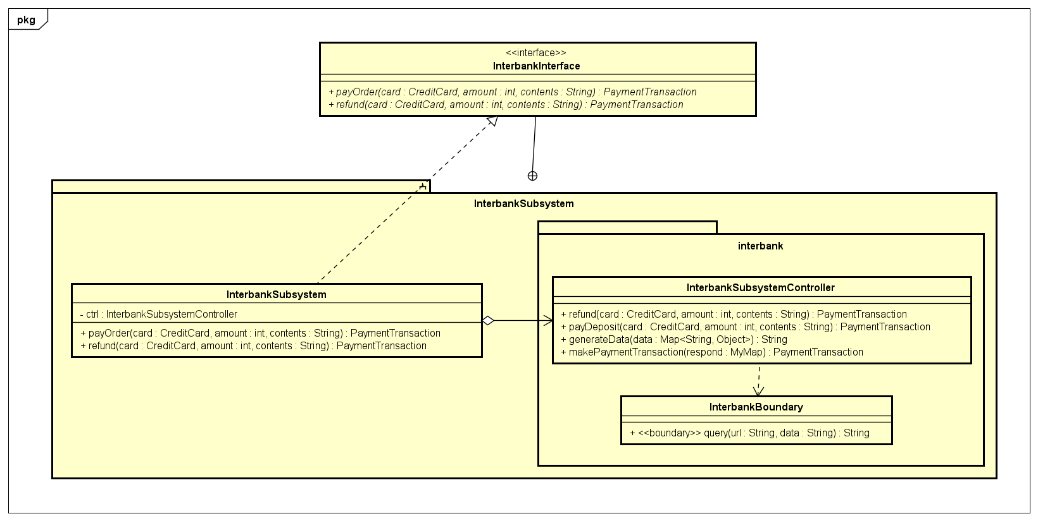
Class diagram – Interbank

Slide 18
Design Considerations

Slide 19
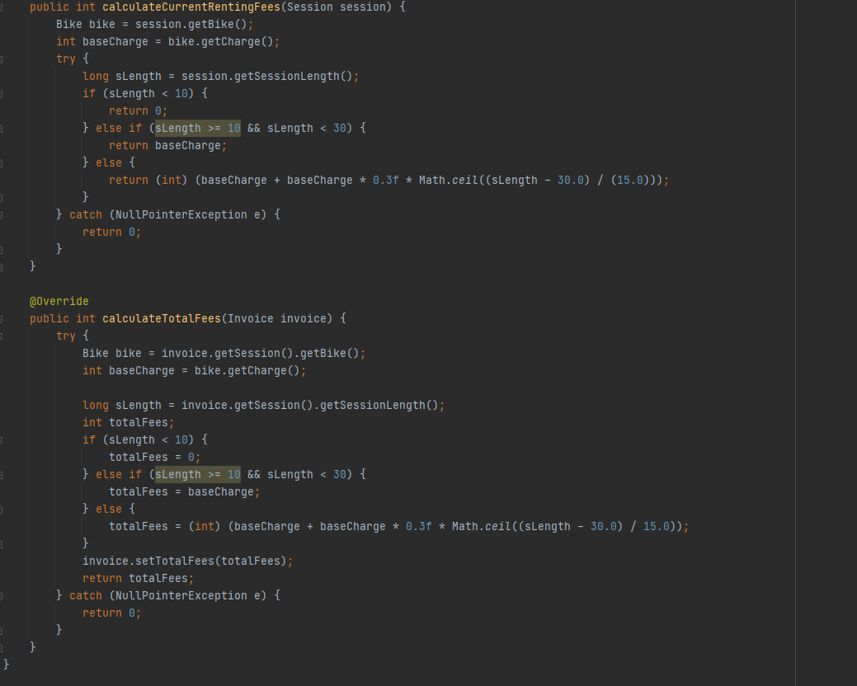
Design Concepts
Coupling
The design has no coupling issues at Content, Common and Control level.
Most components are at Data coupling level, which is already a good design.
There’re a few components are in Stamp Coupling level, but all are nice trade-off with the simplicity of signature.

Slide 20
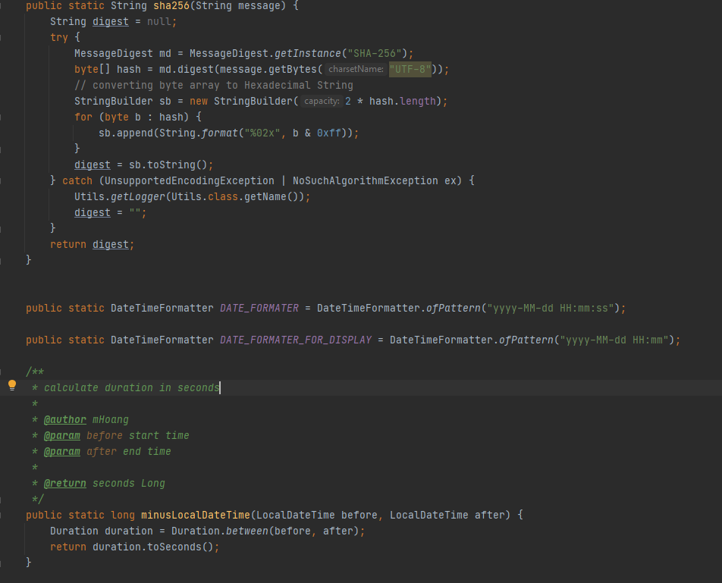
Design Concepts
Cohesion
There is no component with Cohesion issues at Coincidental, Temporal, Procedural and Communicational level.
There’s an exception in class Utils: contains methods for both security (hash) and formatting (time, date, …). However, all those methods are static, and this class acts only as global helper/utility component.

Slide 21
Design Principles
Single Responsibility Principle:
Each of our designed classes follows this principle.
Only exception is the Utils class as it contains method for both security and formatting.
Open / Closed Principle:
Use Strategy Pattern to solve requirement of extending multiple renting fees formulas.
Design also has many parent classes to use for generalization
(2-level inheritance in Bike for easy adding new kind of bike, PaymentCard for adding new payment method, Multilevel inheritance in Handlers for later expansion, etc.)

Slide 22
Design Principles
Liskov Substitution Principle
All the parent class can be substituted by its children classes.
Design has a clear and logical inheritance hierarchy.
Interface Segregation Principle
Interface are compact, contains only needed methods.
E.g. interbank subsystem contains only 2 methods: pay and refund.
Dependency Inversion Principle
Higher-level modules do not depend on lower-level modules.
All subsystem has their own interface for other to use.
Example, for the additional requirement: Extends PaymentCard Class to add more payment methods.

Slide 23
Design Patterns
Singleton:
Use Singleton Pattern to design all manager model classes
As these classes is used as a share-data pool of their responsible models and their construction are quite expensive.
Example: DockManager will store and share data about all queried dock.
Strategy:
Being used as a solution for the violations of Open/Closed Principle.
For example, to solve issues with additional requirement of adding new renting plan: the design uses this pattern in renting fee calculation by making a parent abstract class RentingFeeCalculator then let others type of Calculator extends it.

Slide 24
Design Patterns
Façade:
This pattern is used to reduce complexity of API of a service or interface of a subsystem.
The current design applies this pattern on the interbank subsystem, to make it interface simple and compact.

